Slide 1

Samrat Ashok Technological Institute Vidisha
Subject: Internet Programming Name: Kaushlendra Pathe Scholar Number: 32818 Enrolment Number: 0108IT221025 Semester: [Third Semester] Course: Bachelor’s in Technology Academic Year: [2024-2025]
Submitted To: Professor Smruti Dubey Mam Department of Information Technology Samrat Ashok Technological Institute, Vidisha

Slide 2
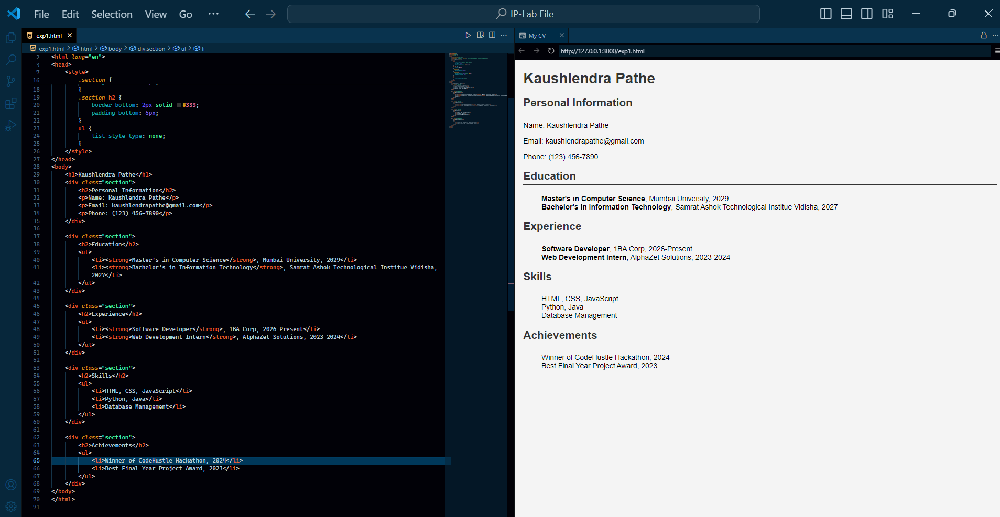
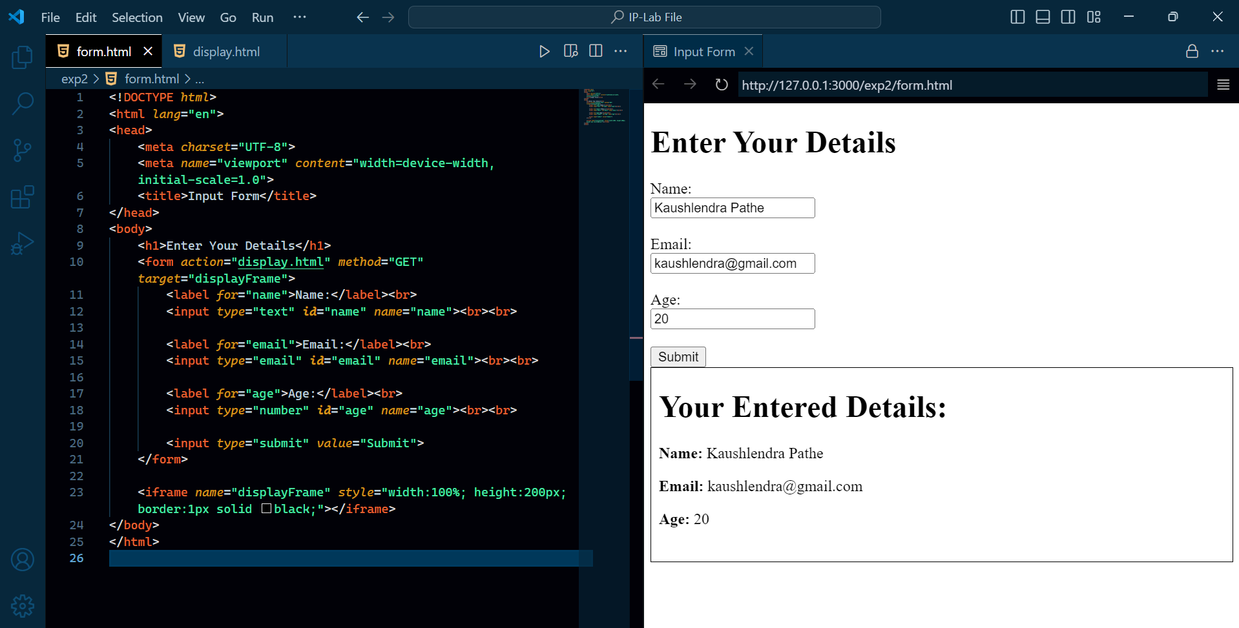
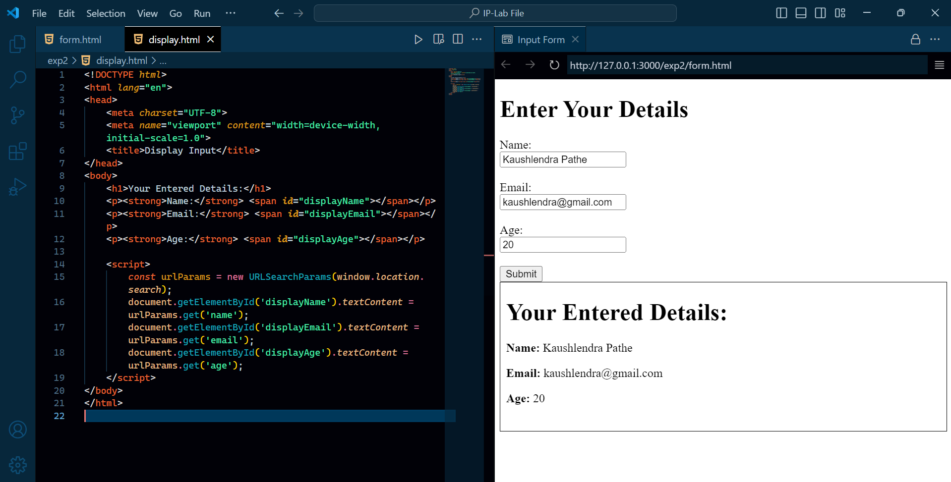
1. Design a web page to display your CV.
2. Design a web page using HTML tags to take the input in a form and display it in another page/frame.

Slide 3
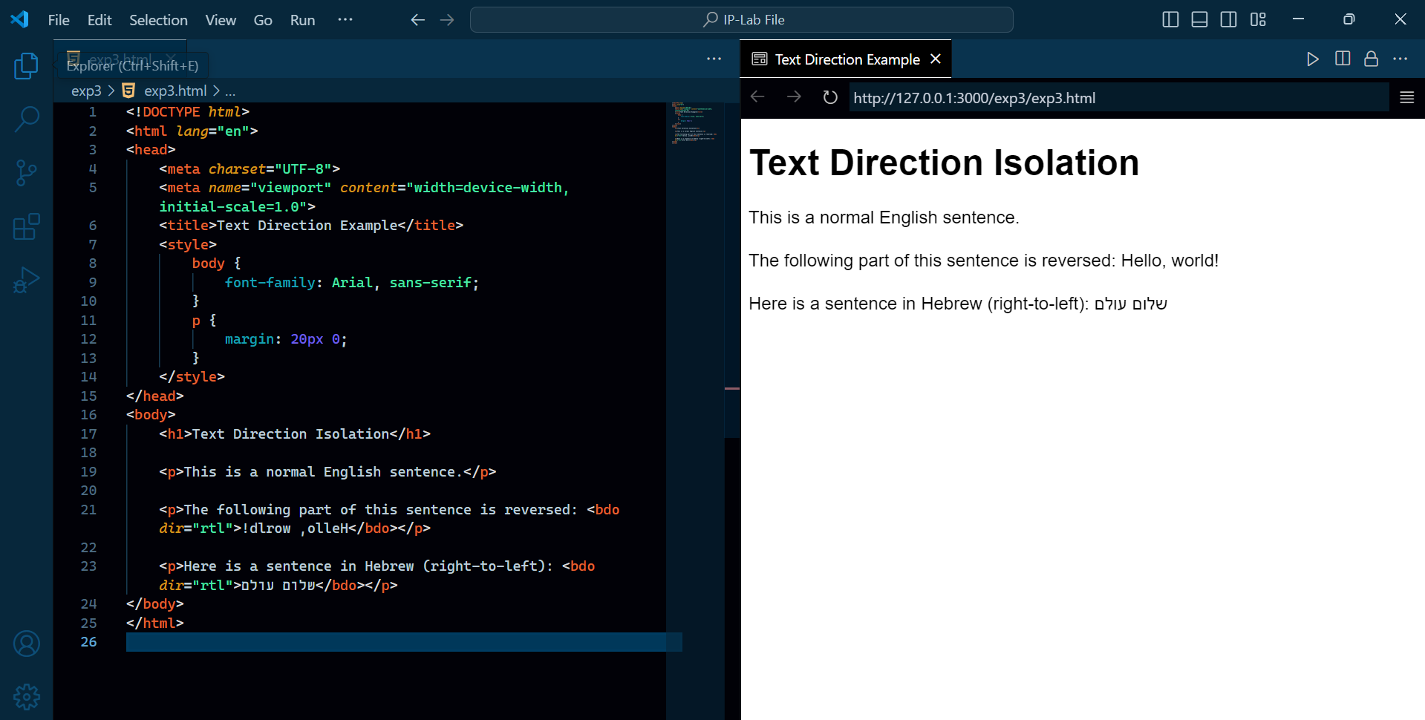
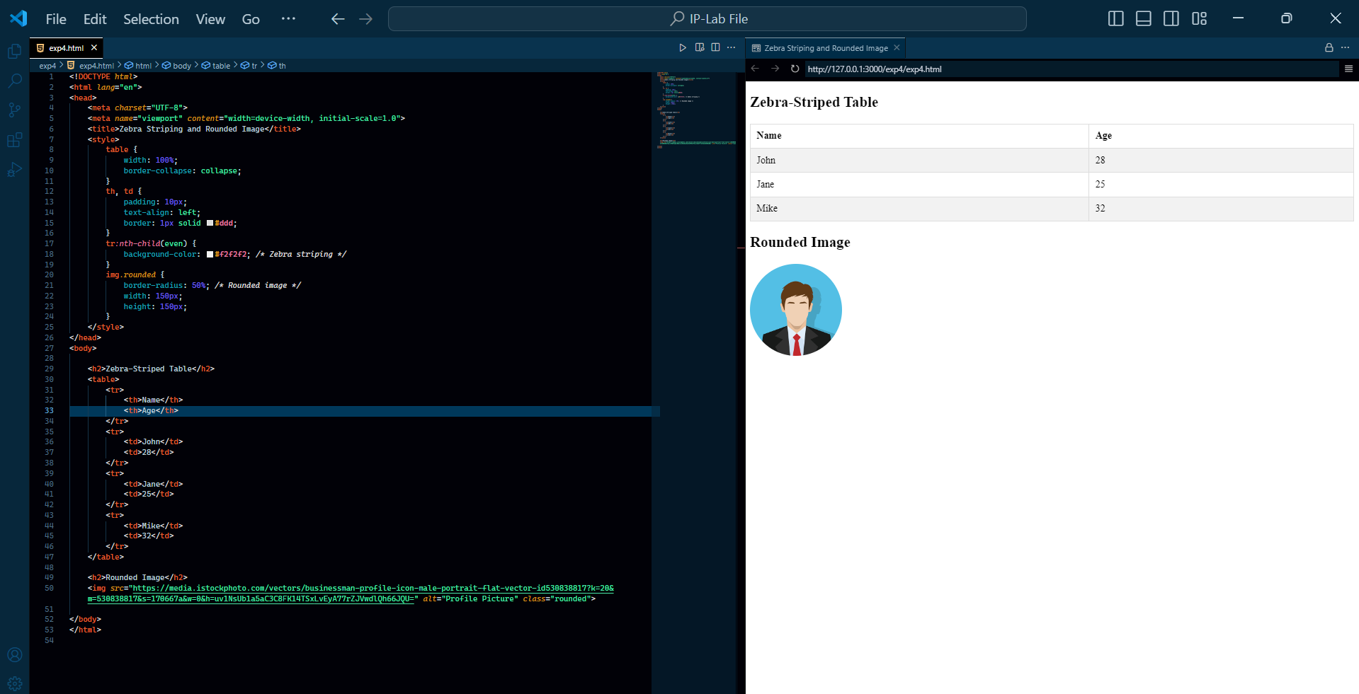
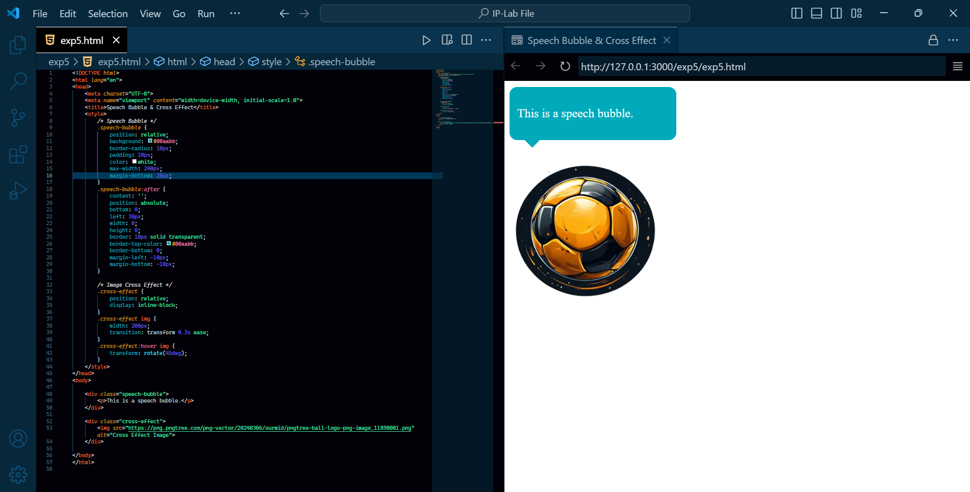
3. Design a web page to isolate a part of the text that might be formatted in a different direction from other text outside it
4. Create a Zebra Striping a Table and make an image rounded with CSS3.
5. Create speech bubble shape and Image cross effect with CSS3 transition.

Slide 4
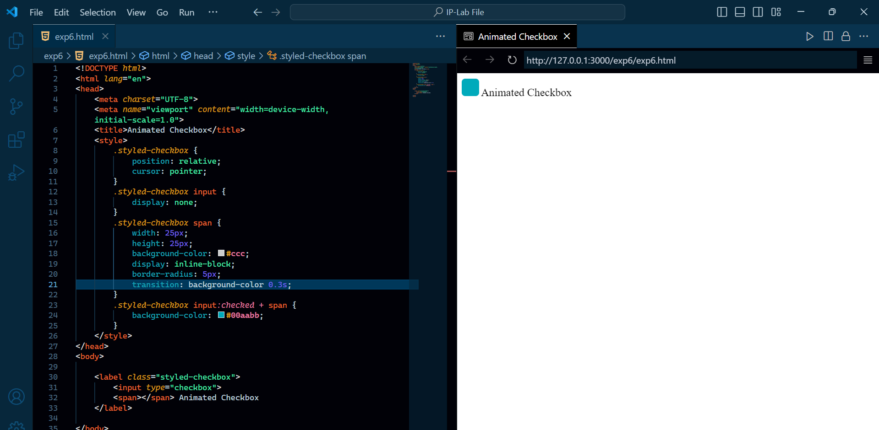
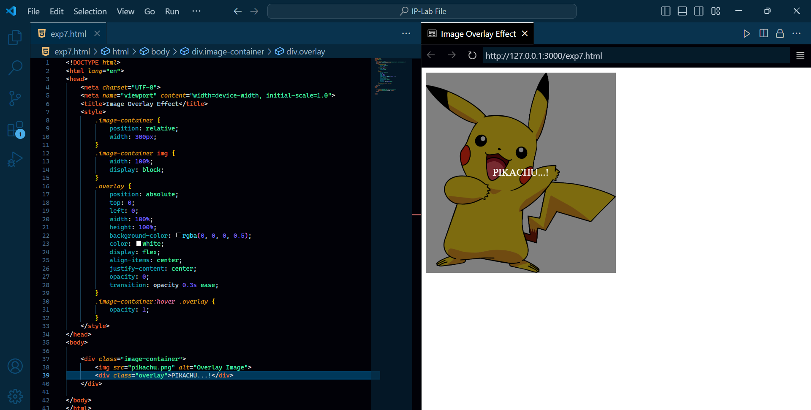
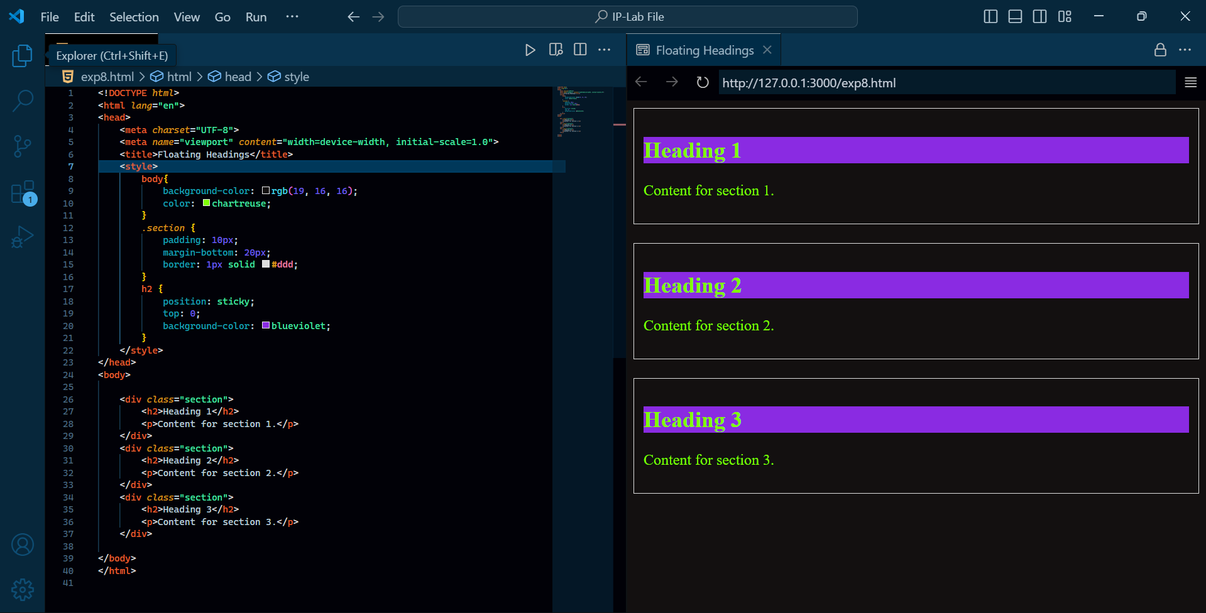
6. Using HTML, CSS create a styled checkbox with animation on state change.
7. Using HTML, CSS create display an image overlay effect on hover.
8. Using HTML, CSS create a list with floating headings for each section.

Slide 5
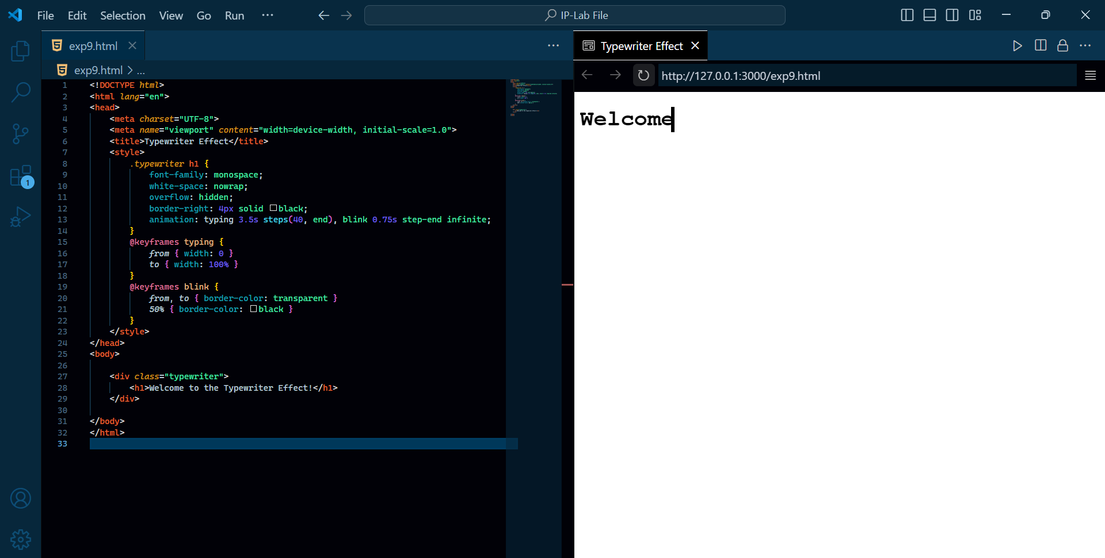
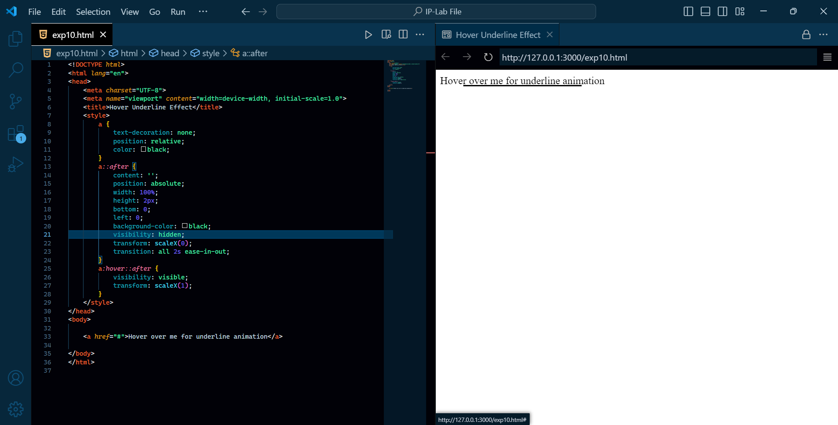
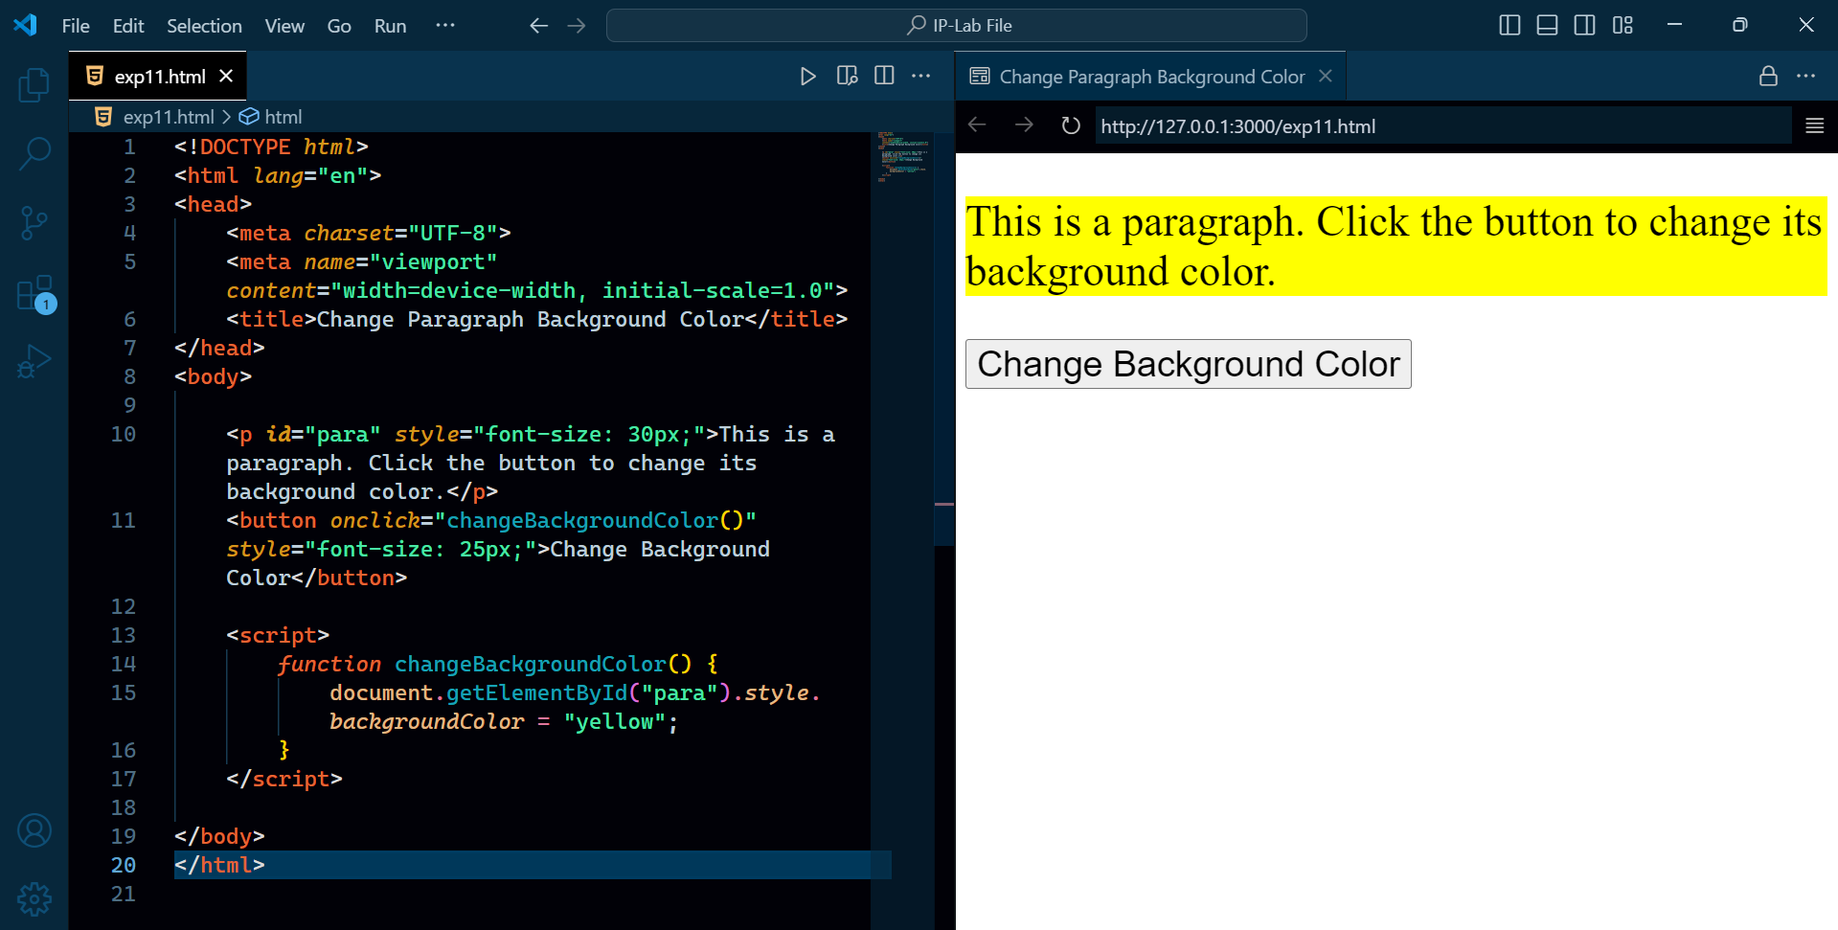
9. Using HTML, CSS, JavaScript create a typewriter effect animation.
10. Using HTML, CSS create an animated underline effect when the user hovers over the text.
11. Write a JavaScript program to set paragraph background color.

Slide 6
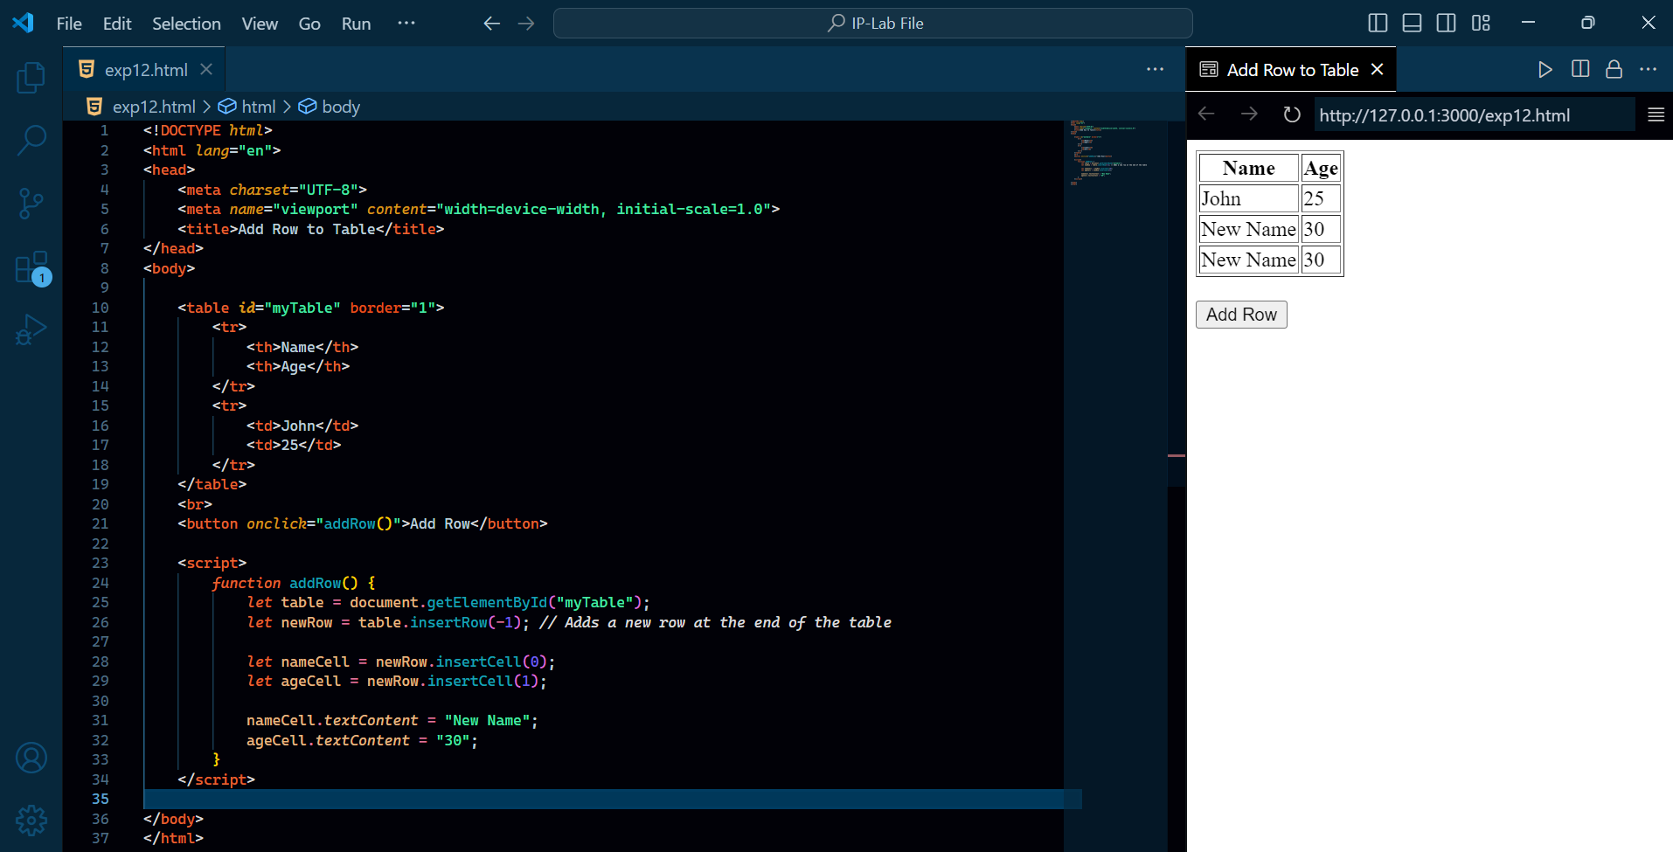
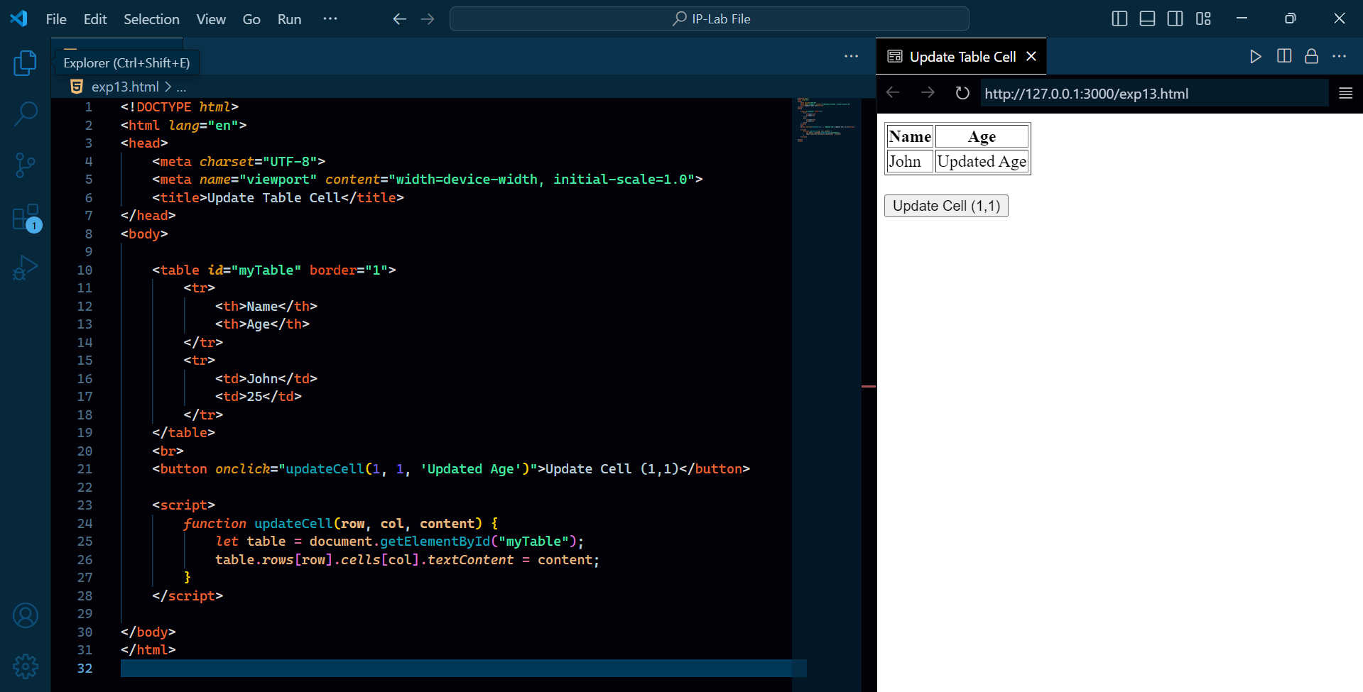
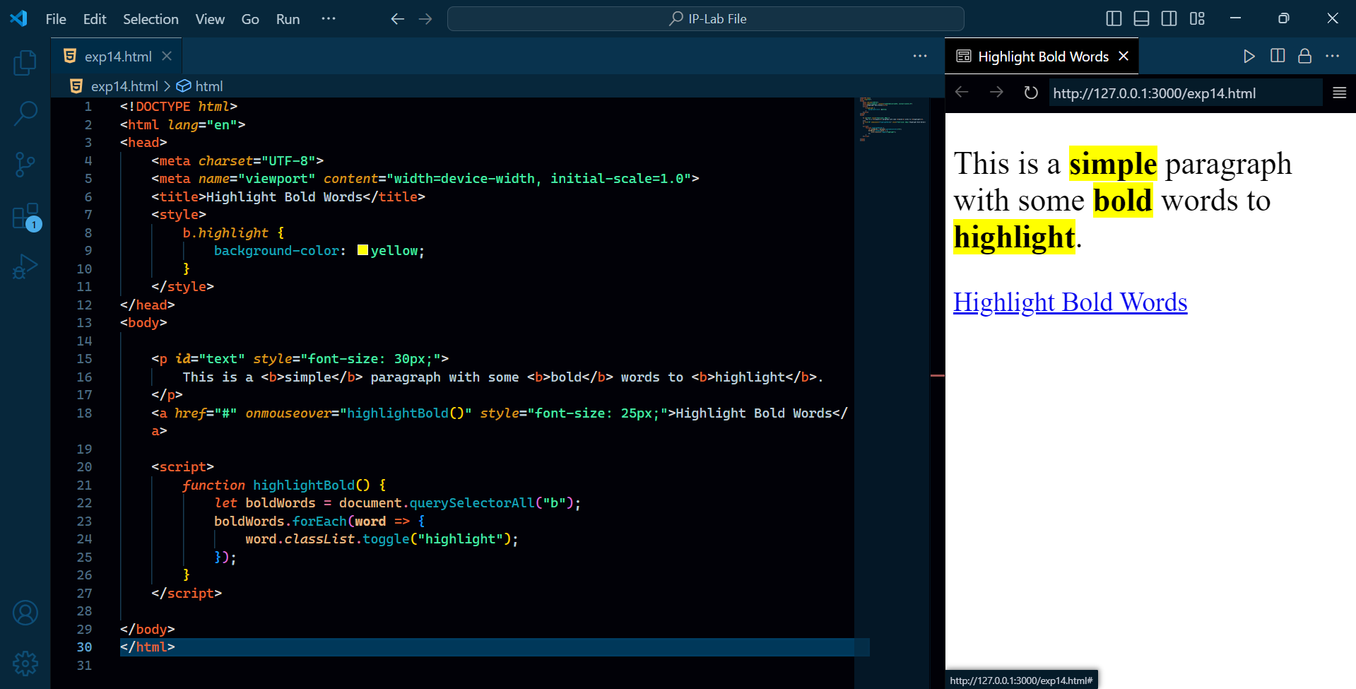
12.Write JavaScript function to add rows to a table.
13.Write a JS function that accepts a row, column(to identify a particular cell) and a string to update the cell’s content
14. Write a JavaScript program to highlight the bold words of the following paragraph, on mouse over a certain link.

Slide 7
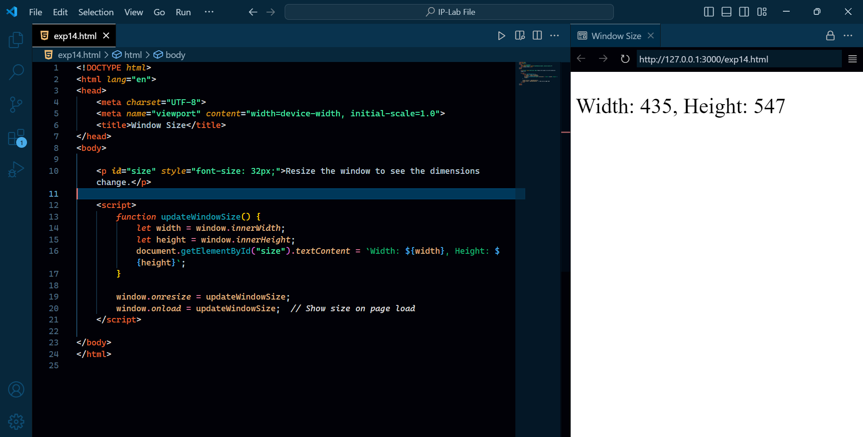
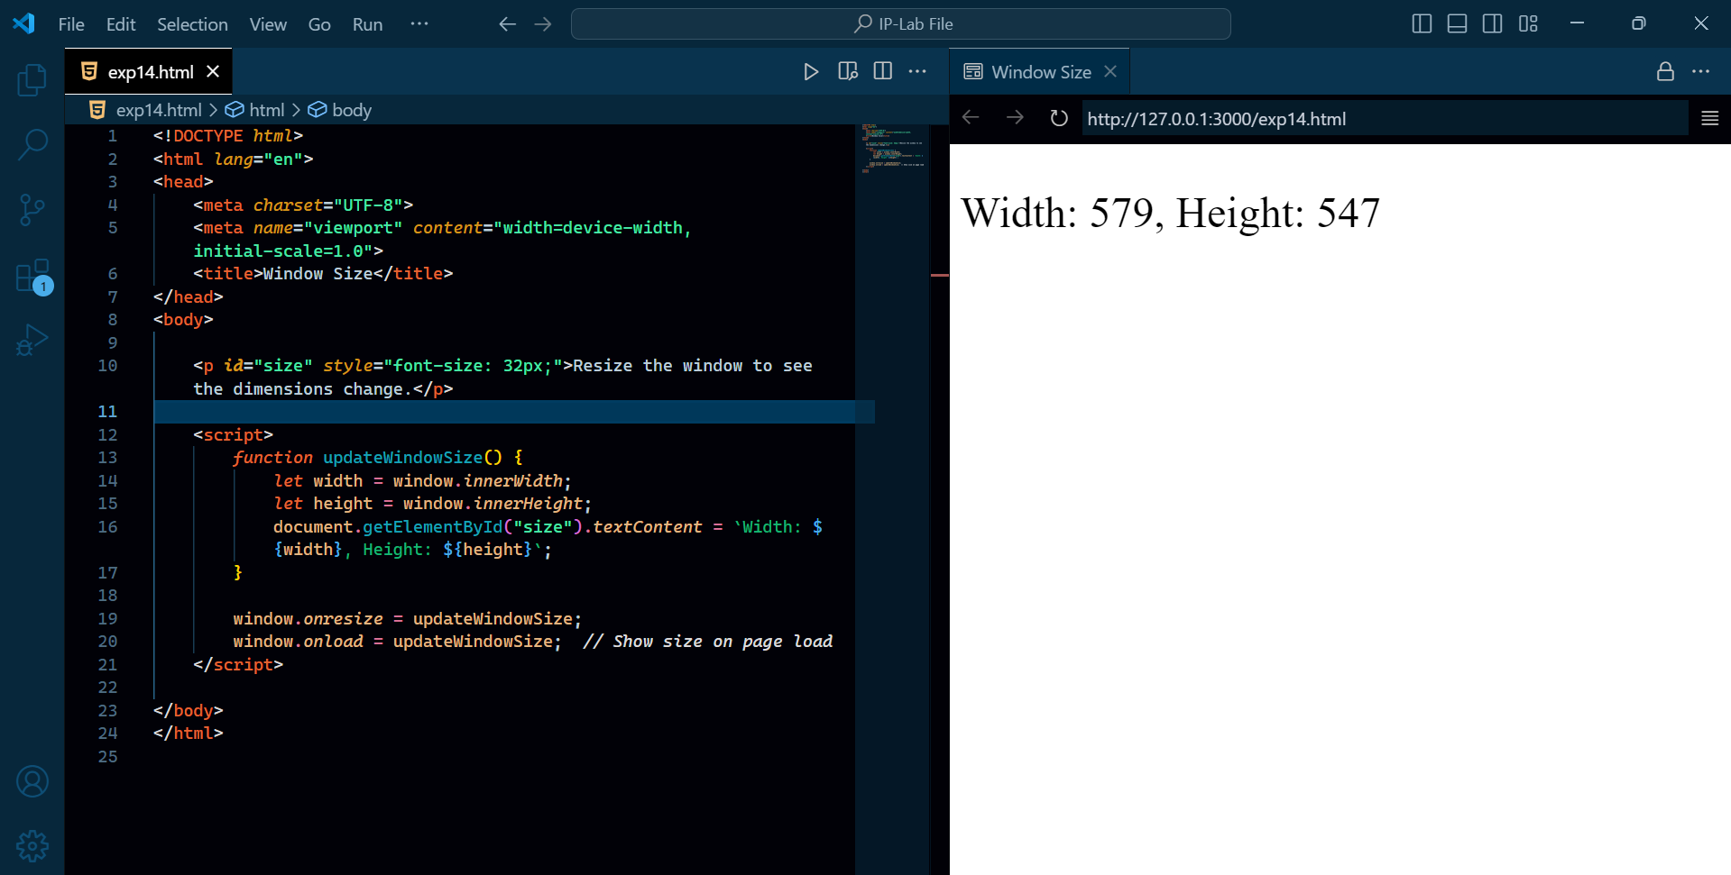

15. Write a JavaScript program to get the window width and height (any time the window is resized).
GitHub Repo QR Code

